Slide 1



DOMAIN
HEALTH CARE

Slide 2


BREAST CANCER
​

Slide 3

Embracing the Fight Against Breast Cancer
domain
PROBLEM STATEMENT
Health Care
Healthcare is a fundamental aspect of society, encompassing a range of services aimed at promoting, maintaining, and restoring health.
BREAST CANCER
Develop innovative solutions to enhance early detection, accurate diagnosis, and personalized treatment of breast cancer, ultimately improving patient outcomes and survival rates.

Slide 4









Meet the team
2110030032​​
2110030014
G.HARITHA MAITHREYEE
DEVINEEDI NEHA
2110030315​​
2110030324​
V.AISHWARYA
CH.NAVYA

Slide 5


INTRODUCTION:
Breast cancer is a significant health concern worldwide, affecting millions of individuals each year.
Accurately diagnosing breast cancer is challenging due to the variability in tumor characteristics and the potential for false positives or false negatives.
Breast cancer diagnosis involves analyzing various factors such as tumor size, shape, and behavior, which can be complex and require expertise.
Inaccurate diagnosis can lead to delayed treatment, unnecessary interventions, and adverse outcomes for patients.

Slide 6


PROBLEM STATEMENT
Embracing the Fight Against Breast Cancer,' we aim to redefine the landscape of breast cancer detection through cutting-edge data-driven methodologies.
By harnessing the power of machine learning algorithms and advanced data analytics, our goal is to develop a highly accurate and efficient system for early detection of breast cancer.
Early detection significantly improves breast cancer prognosis by enabling timely treatment initiation when the disease is more manageable.

Slide 7

SOLUTION BREAKDOWNN
STEP 1: DATASET COLLECTION
STEP 2: PREPROCESSING
Handling Missing Value
Feature Scaling
Training and Testing Sets
Collect accurate data set to meet the above requirements.
STEP 3: Logistic Regression Model
STEP 4: User Interaction
Input Features
Simulation After Result
PET,CA TEST
User-Friendly Interface
Model Training
Predictive Accuracy

Slide 8
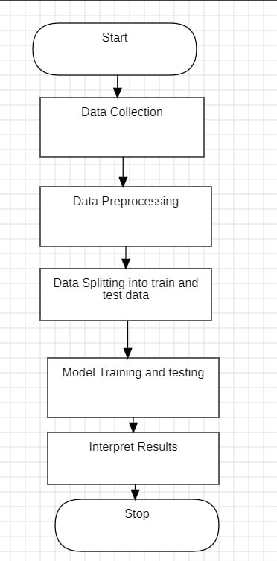
FLOW CHART:
This is the flow chart for solution breakdown.

Slide 9

implementation
Import Libraries
Necessary libraries like pandas for data manipulation, scikit-learn for training-testing splitting, scaling, model building and evaluation (train_test_split, StandardScaler, LogisticRegression, accuracy_score), and NumPy for numerical operations.
Load Data
Read the breast cancer dataset (breast-cancer.csv) using pandas.
Preprocessing
Drop unnecessary columns (e.g., 'id').
Separate features (X) and target variable (y).
Scale numerical features using StandardScaler.
Train-Test Split: Split the preprocessed data into training and testing sets (e.g., 70% training, 30% testing) using train_test_split.

Slide 10
IMPLEMENTATION
Model Training
Defnie a Logistic Regression model.
Train the model on the training data.
Evaluation
This focuses on prediction, you can calculate the model's accuracy on the test set using accuracy_score to assess its overall performance.

Slide 11

FUTURE WORK
DOCTOR’S LOGIN
GENERATING REPORT
Access to Patient Records
Communication and Collaboration
Decision Support
Diagnosis
Treatment Planning
Monitoring Progress
LIVE MAPS
HOSPITALS
Disease Surveillance
Resource Allocation
Education and Awareness
Access to Specialists
Community Outreach
Treatment Options

Slide 12

OUTPUTS

Slide 13
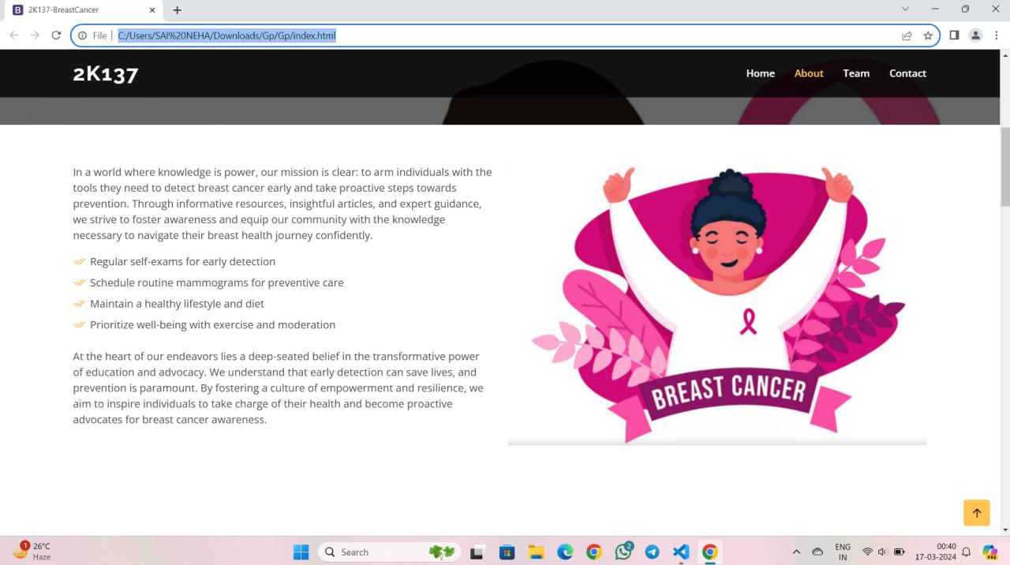
OUTPUTS

Slide 14
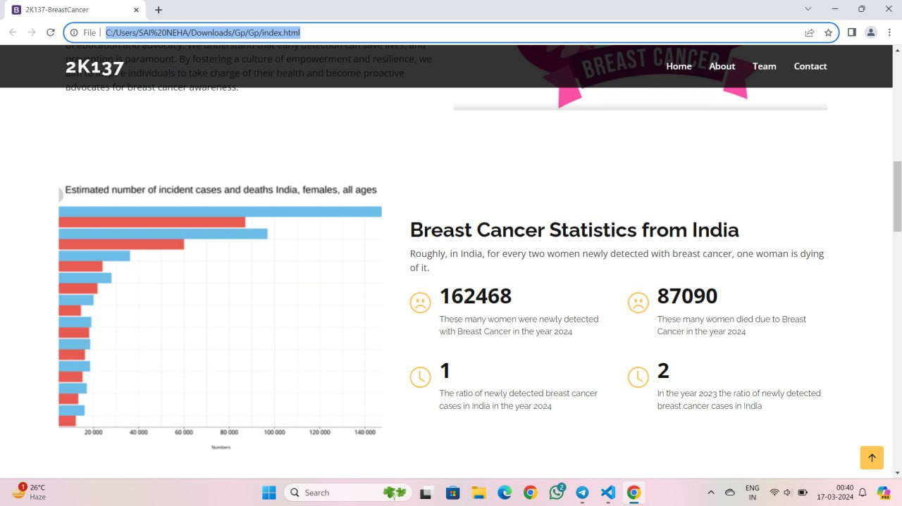
OUTPUTS

Slide 15
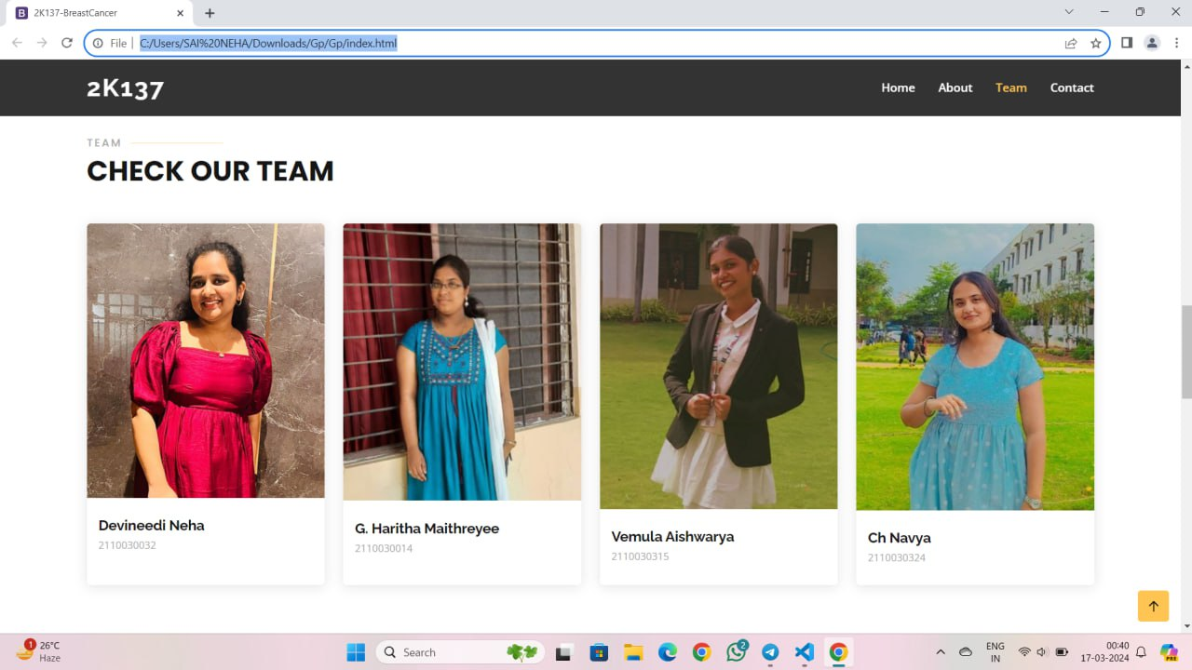
OUTPUTS

Slide 16
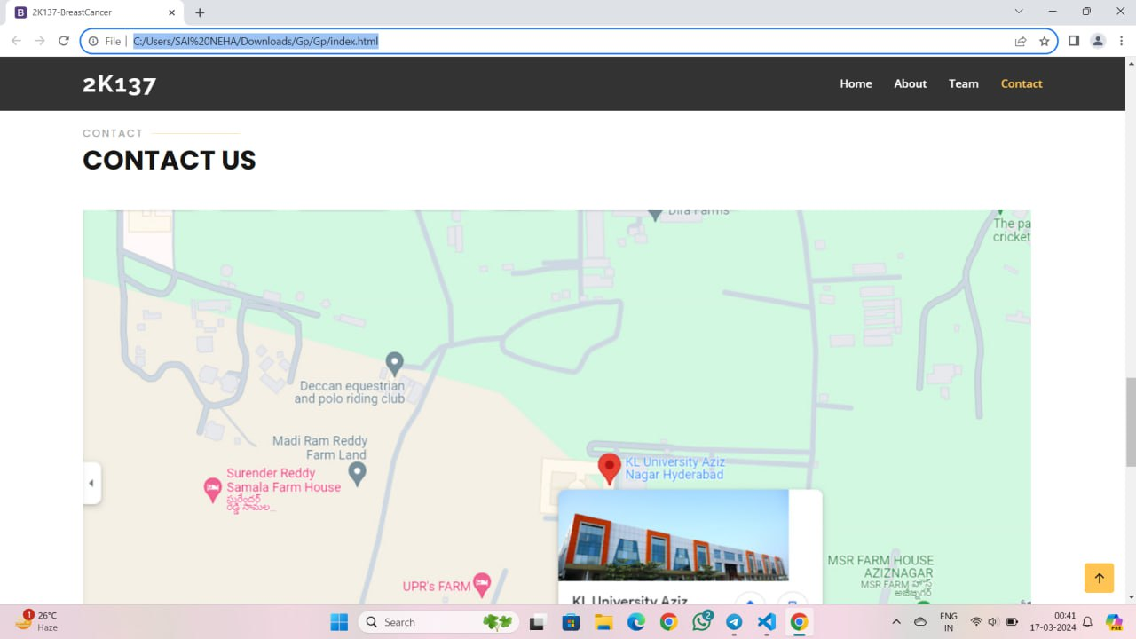
OUTPUTS

Slide 17
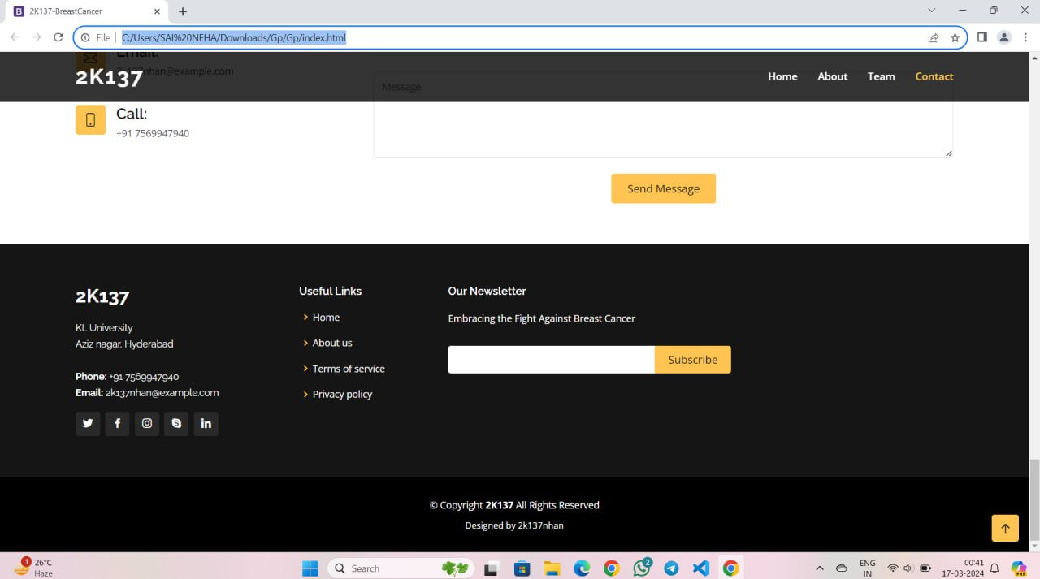
OUTPUTS

Slide 18
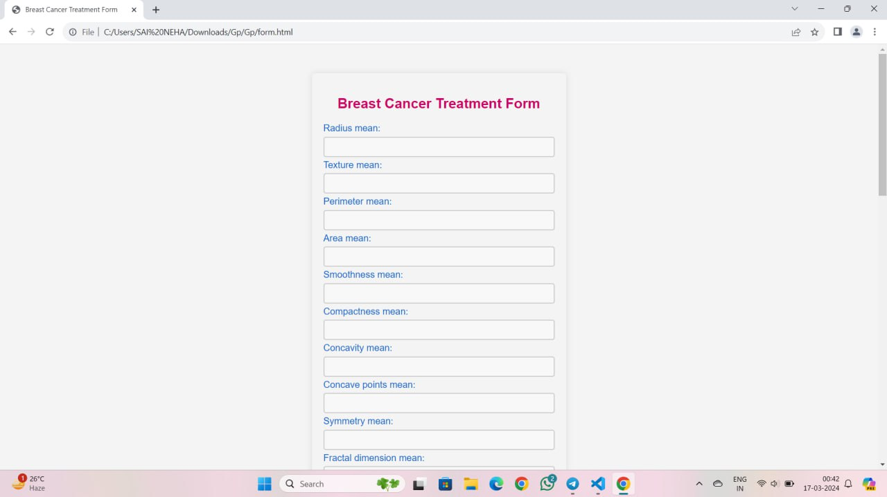
OUTPUTS

Slide 19

CONCLUSION
This project demonstrated the application of logistic regression for breast cancer prediction using a well-known breast cancer dataset.
The model achieved an accuracy of 97.37% on the test set, indicating its potential to classify breast cancer diagnoses.
Logistic regression offers interpretability, allowing us to understand the contribution of each feature to the model's predictions.

Slide 20

THANK YOU

